Slide 1
Maze & bfs & dfs
AP MidProject
By : Maryam Barazande

Slide 2
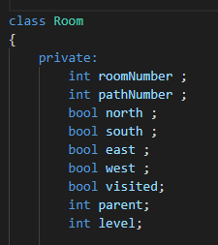
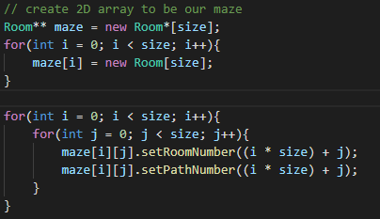
Algorithm to make a maze
Class room is the base structure
Build a size * size pointer to pointer of type class to make a square type maze
The aim is to reach the last room starting from first room
Don’t forget to delete the room we made as new at the end of program

Slide 3
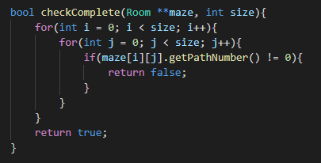
make connection between rooms
The method I chose is:
We get a number in range size*size in random that is the number of the class
Until all rooms are not chosen we continue. To check that we have a member named PathNumber that change every time and continue till the PathNumber of all rooms get to zero.
The challenges we face is:
Make sure that we have connection between all rooms and do not have independent part
Make sure that we have at least one way from beginning room to the final room to solve the maze
Have different ways and neighbors

Slide 4
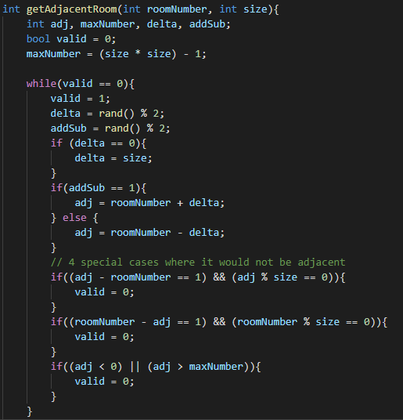
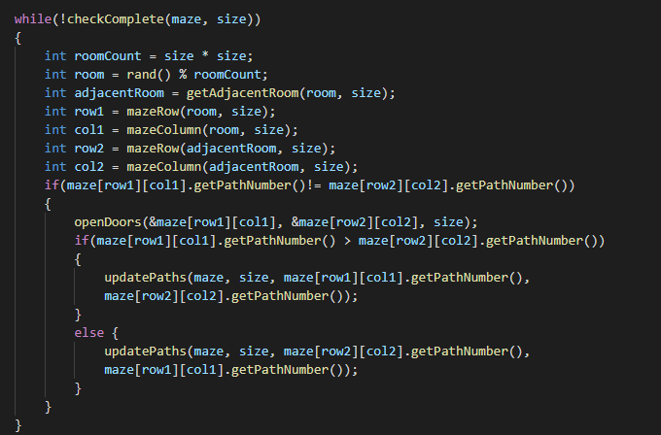

Slide 5
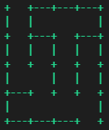
How to show the maze
1
2
3
4

Slide 6
DFS ALGORITHM
DEPTH SEARCH FIRST

Slide 7
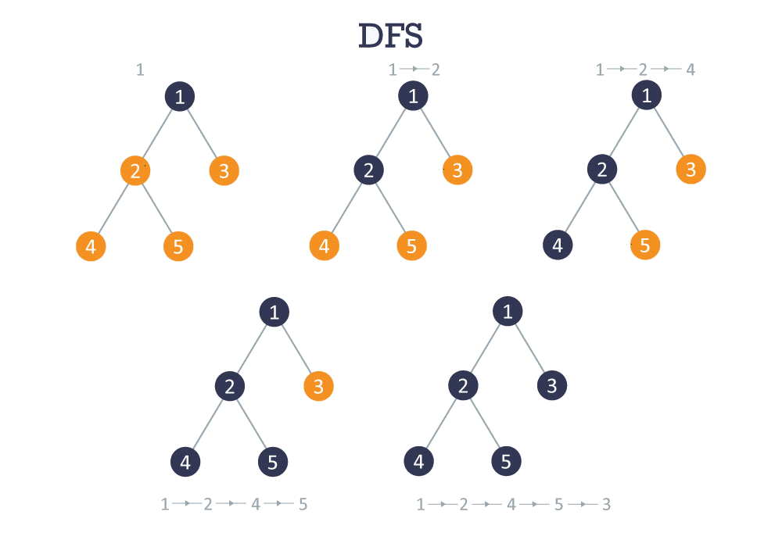
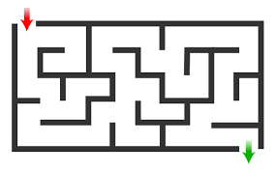

Slide 8
1. Start from first room and push this node in a list 2.Set this rom as visited 3.Check the neighbors and call a backtracking function with the first neighbor (if it has some) 4. do this till we get to the end 5. if we face a dead end we should get back to parent room (the room we interred first) 6.when we get to the end, then the function must return

Slide 9
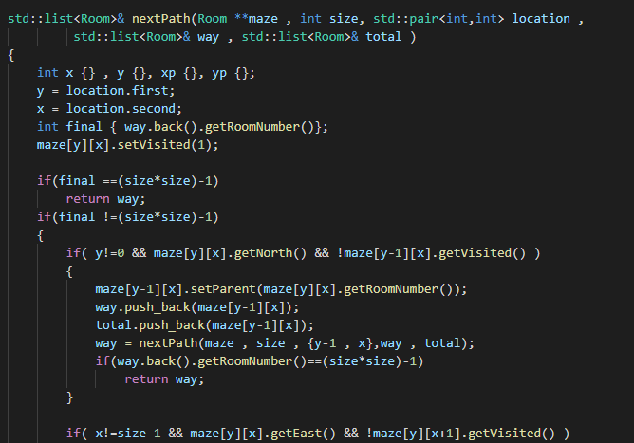
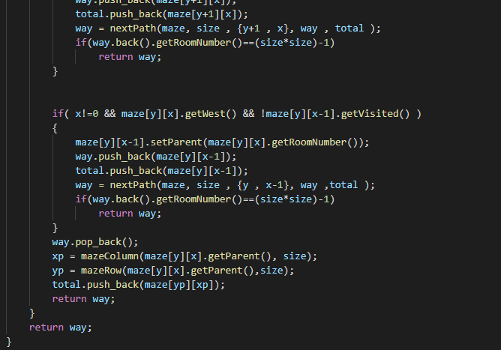

Slide 10
BFS ALGPRITHM
BREADTH FIRST SEARCH

Slide 11
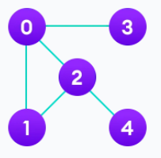
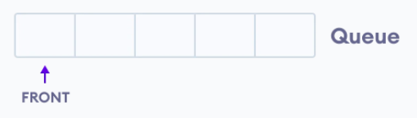
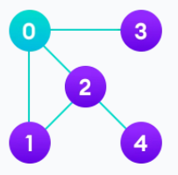
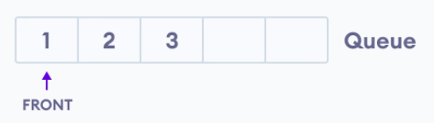
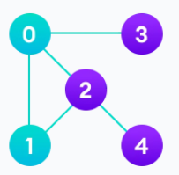
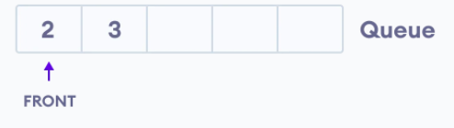

Slide 12
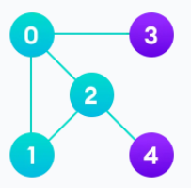
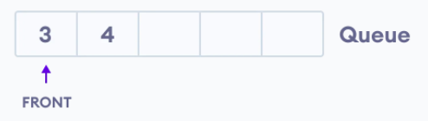
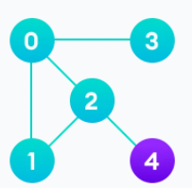
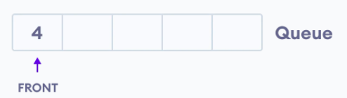
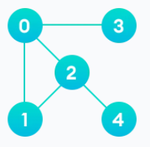
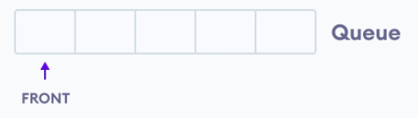

Slide 13
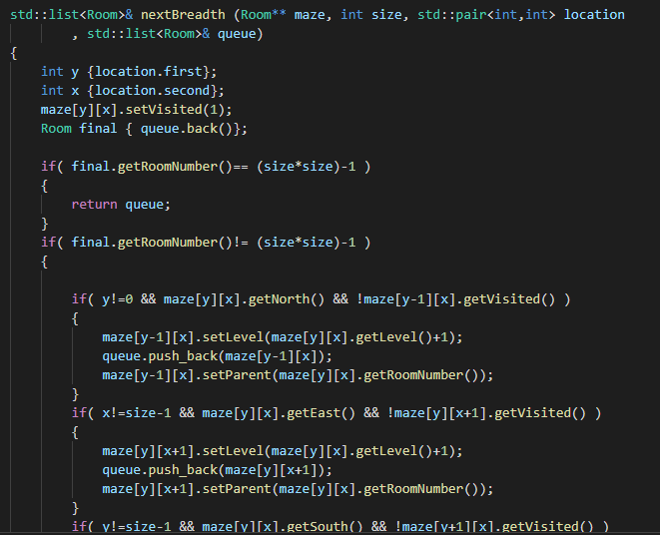
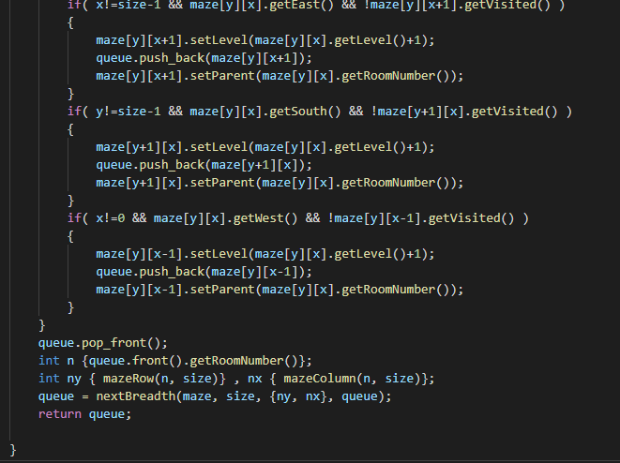

Slide 14
How to show the solution
To show the steps every time we draw a maze with an object which is in current location, then we delete the outputs using code below:
std::cout << "\033[2J\033[1;1H";
Then we step forward and show the next step
In DFS we use the list which includes the path
In BFS we use the level which is set in algorithm
Continue the steps until we solve the maze (reach the last room)
To have more user interface I used colored output by defining different colors.
Example:
#define GREEN "\033[1m\033[32m" /* Bold Green */
#define MAGENTA "\033[1m\033[35m" /* Bold Magenta */
#define CYAN "\033[1m\033[36m" /* Bold Cyan */

Slide 15
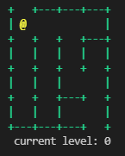
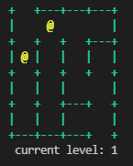
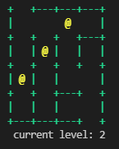
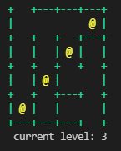
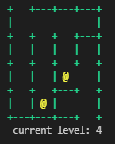
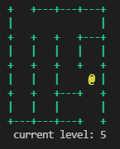
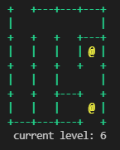
Here is an example of output in two ways:
BFS method:

Slide 16
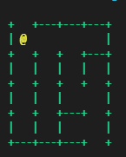
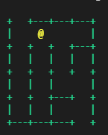
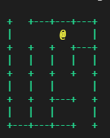
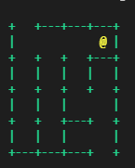
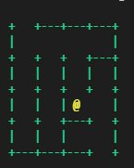
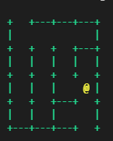
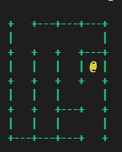
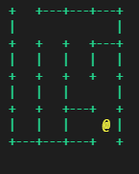
Here is an example of output in two ways:
DFS method:
1
2
3
4
5
6
8
9
10
11
7

Slide 17
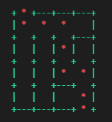
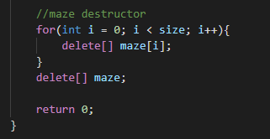
At last we should delete:
And after that we show the main path than we talked:

Slide 18
Thanks for watching!

